Slide 1


Slide 2
Presented By :
HAMMAD MUHAMMAD (Numl-F23-48942)
Abdul Mannan Bhatti (Numl-F23-43496)
Rameez Hassan Raja (Numl-F23-50489)
Javad Ahmed (Numl-F23-55006)
Muhammad Ajwad Rana (Numl-F23-39043)

Slide 3
Presented to :
Miss Irrum

Slide 4
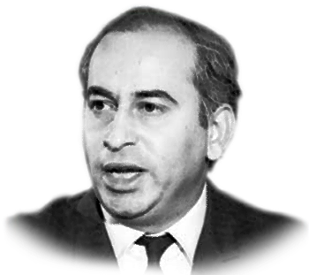
ZULFIQAR ALI BHUTTO (5 January 1928 ---4 April 1979)
Topic

Slide 5
Introduction :
Born on 5th January 1928 (Sindh)... his father Sir Shah Nawaz.
He studied at California, Oxford and Lincoln’s inn University.
4th President and 9th Prime Minister of Pakistan.
Founder of Pakistan Peoples Party (PPP).
1963 appointed as Foreign Minister of Ayub Cabniet
1971 war and Simla Agreement in 1972.
1974 Hosted the second OIC in Lahore.
Father of Nuclear Program
Policy of Nationalization.
He trusted Zia-ul-Haq overthrow him and later he was executed.

Slide 6
Foreign Minister of Pakistan and PPP:
1963 become Foreign Minister.
Socialist views…good relations with China and Russia.
Johnson critisized Bhutto…threat to cut aid.
Sino-Pak boundary agreement on 2nd March 1973.
Wanted Foreign Policy independent of US influence.
Visited east, west, Germany and Poland.
“Operation Gibraltar” ont the direction of Bhutto…1965 war.
Tashkent Agreement….left Ayub Khan…30 Nov 1967 formed PPP.
Didn’t accept Ayub Khan in Office and Mujib Six Point Formula.

Slide 7
1973 Constitution:
Zulfiqar Ali Bhutto played a pivotal role in the formulation of Pakistan's 1973 Constitution, advocating for a democratic and federal framework.
The constitution marked the end of a decade-long period of martial law and established civilian rule, emphasizing the rule of law and democratic governance.
It enshrined the principles of federalism, granting significant autonomy to the provinces, aiming to empower local governments and ensure equitable distribution of resources.
Bhutto's constitution guaranteed fundamental rights to all citizens, including equality before the law, freedom of speech, religion, and the press.
While ensuring a democratic framework, Bhutto's constitution also included Islamic provisions to reflect the country's status as an Islamic republic.
The constitution established a parliamentary system with a bicameral legislature, consisting of the National Assembly and the Senate.

Slide 8
1973 Constitution:
It introduced reforms in the judiciary, including the establishment of the Supreme Court and High Courts, ensuring the independence of the judiciary.
It recognized and safeguarded the rights of religious and ethnic minorities, promoting inclusivity and diversity within the nation.
Zulfiqar Ali Bhutto's contributions through the 1973 Constitution continue to shape Pakistan's political and constitutional landscape, serving as a cornerstone of the country's governance system.

Slide 9
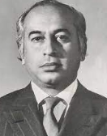
President and Prime Minister of Pakistan:
He became president on 20 Dec 1971
He became the first Civilian Chief Martial Law Administrator
He Released Sheikh Mujib-ur-Rehman
He appointed Tikka Khan as Army chief(1972)
He visited India and Signed Simla Agreement.
14 May 1973 he became Prime Minister.

Slide 10
INTRODUCTION

Slide 11
INTRODUCTION

Slide 12
INTRODUCTION

Slide 13
INTRODUCTION

Slide 14
INTRODUCTION

Slide 15
INTRODUCTION

Slide 16
INTRODUCTION

Slide 17
INTRODUCTION

Slide 18
INTRODUCTION

Slide 19
INTRODUCTION

Slide 20
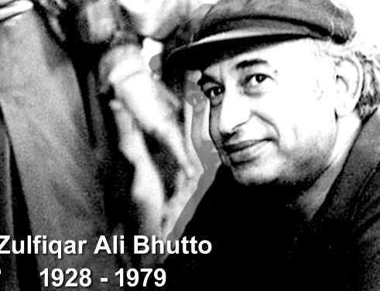
Death of Zulfiqar Ali Bhutto:
Difference with Wali Khan (NAP)…100,000 troops were in KPK Baluchistan.
8 January 1977 opposition formed Pakistan National Alliances.
3 July 1977 Bhutto was informed...coup...started negotiations.
5 July 1977 Zia imposed martial law and arrested Bhutto.
Ahmed Raza Casuri’s father death.
3 Sep1977 arrested of authorizing the murder.
Released 10 days later.
17 Sep 1978 sentenced to death…Zia-ul-Haq could save him… Handed 4 April 1979…Libya’s Colonel Gadhafi offer.

Slide 22
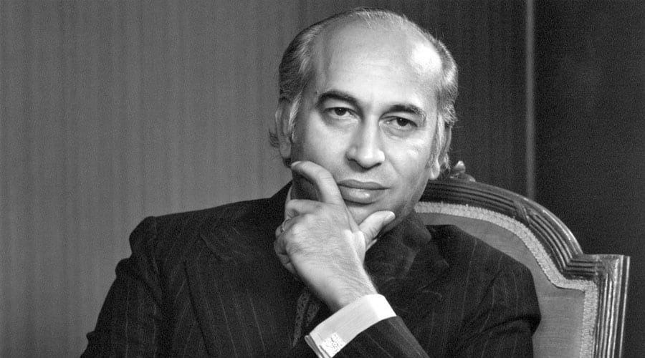
THANK YOU

